Slide 1
Data Logger for a Mechanical System
Team Members:
Abdulrahman Al-Malki
Faisal Al-Mutawa
Mohammed Alsooj
Yasmin Hussien
Mentor: Dr. Shehab Ahmad

Slide 2
Outline
Problem Statement
Brief Description
Design Constraints
Similar Products
Budget
Timeline
Applications
Conclusion

Slide 3
Problem Statement
“Bringing passive tools to use.”

Slide 4
Problem Statement
Wells
Citations 1-3

Slide 5
Brief Description
Electronic add-on to mechanical systems, designed to work in harsh environments.
Constitutes of a PCB that is approximately 6 inches long.
Contains microprocessor, flash memory, and sensors.
Sensors may include accelerometer, hall sensors, temperature and pressure sensors.

Slide 6
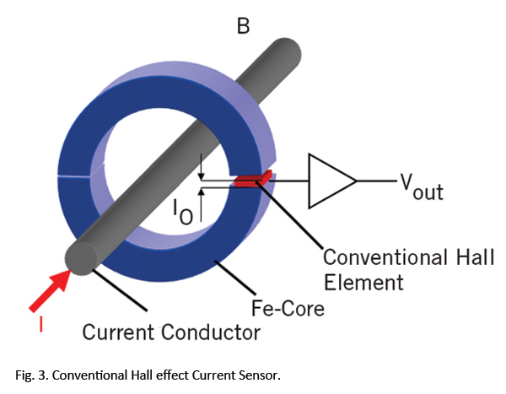
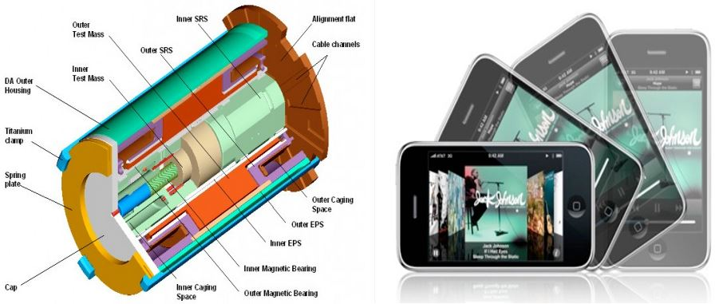
Brief Description

Slide 7
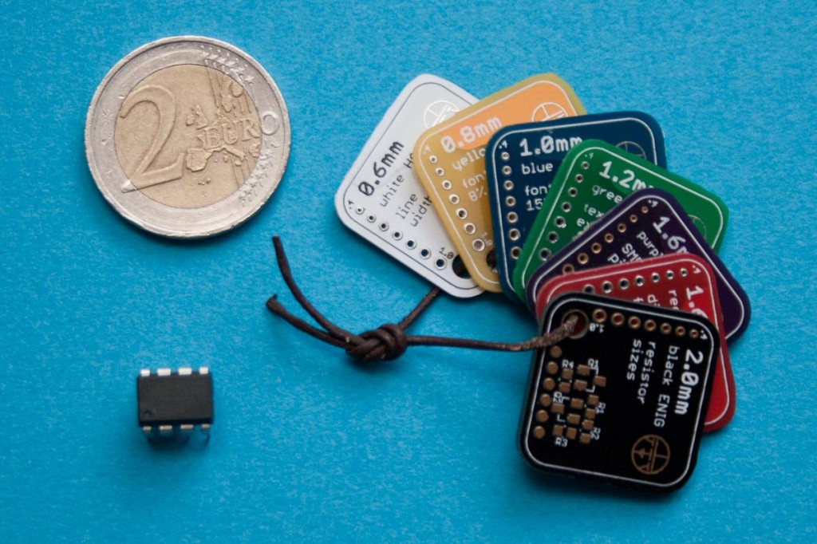
Design Constraints
Size
Power
Durability
Citations 5-6

Slide 8
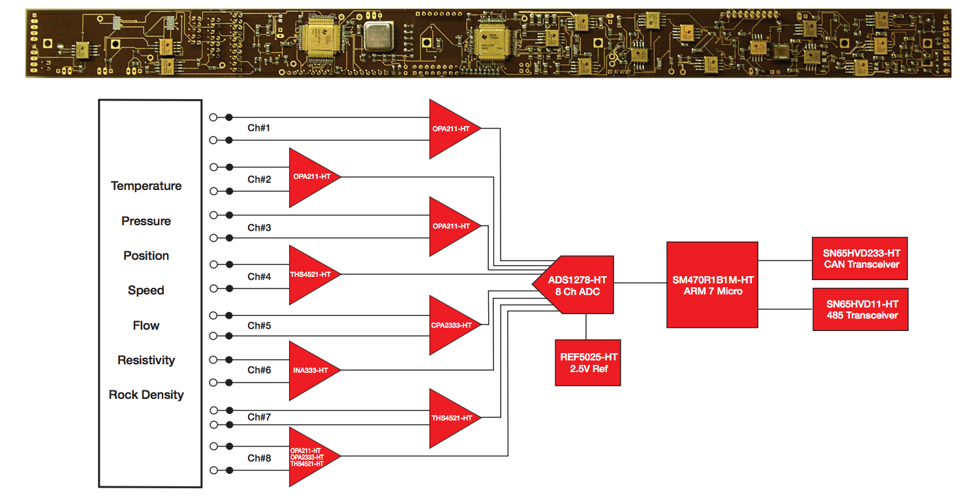
Similar Products Texas Instruments: H.E.A.T. Board “Harsh Environment Acquisition Terminal”
15.6”
1.1”
Price= $5749.00
Citation 4

Slide 9
Initial Budget
Table 1: The estimated prices of our components
Component | Estimated Price
Polyimide PCB (Printed Circuit Board) | ~$500
Microchip Processor (16Bit) | ~$50
Flash Memory (512Mb) | ~$100
Sensors Total: | ~$1000
Linear Variable Differential Transformer | ~$400
Accelerometers | ~$100
Other Sensors | ~$500
Miscellaneous | ~$100
Shipping & Taxes | ~$200
Total = ~$1,950

Slide 10
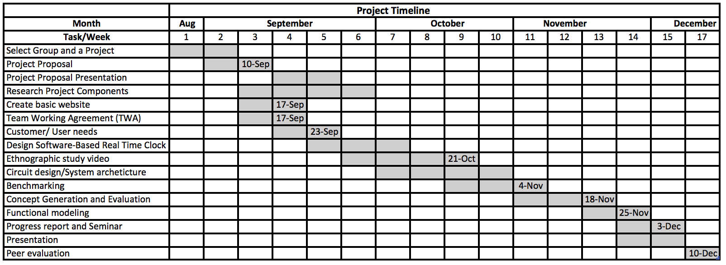
Timeline and Tasks

Slide 11
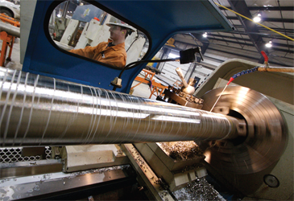
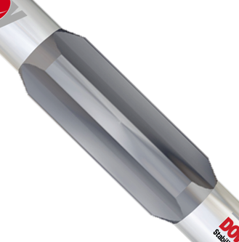
Applications
Drill Collar
Stabilization Tool

Slide 12
Conclusion
Circuit board for a passive mechanical tool
Bicycle analogy

Slide 13
References
http://www.slb.com/
http://www.rasgas.com/
https://www.qp.com.qa/en/Pages/Home.aspx
http://www.ti.com/tool/heatevm
http://www.justgeek.de/pcb-sample-set/
http://www2.imec.be/be_en/press/imec-news/archive-2009/imec-reports-ultra-thin-chip-embedding-for-wearable-electronics.html

Slide 14
Thank you for listening!
Any Questions?

