Slide 1
Data Logger For Mechanical Systems
Group 1:
Abdulrahman Al-Malki
Faisal Al-Mutawa
Mohammed Alsooj
Yasmin Hussein

Slide 2
Outline
Objective
Customer Needs
Ethnographic
Functional Modeling
Benchmarking
Concept Generation & Selection
Preliminary Design and Budget
Progress
Conclusion

Slide 3
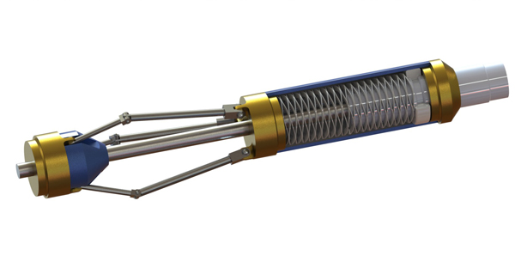
Objective
+our product
Dumb tool
Smart tool
Citations 1-2

Slide 4
Customer Needs
Two personal interviews and one phone interview
Focus on:
Vibration and acceleration
Prioritize accuracy

Slide 5
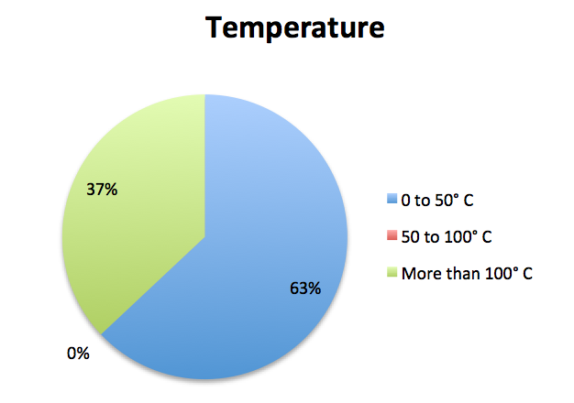
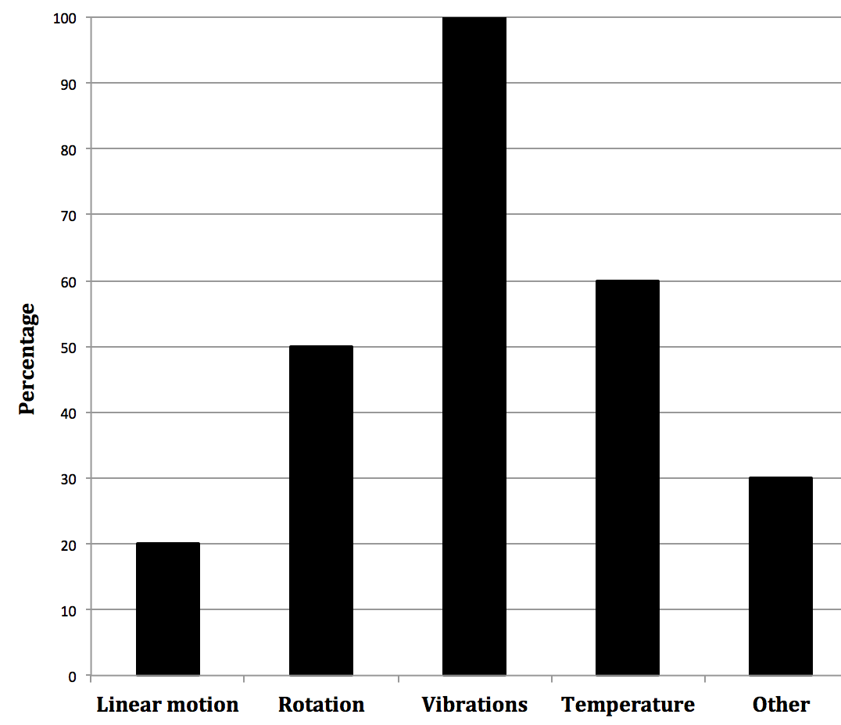
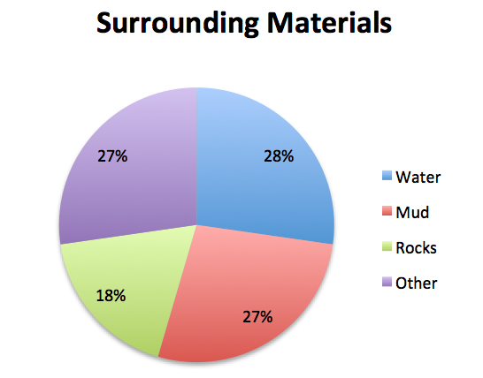
Customer Needs
Type of data
Environment

Slide 6
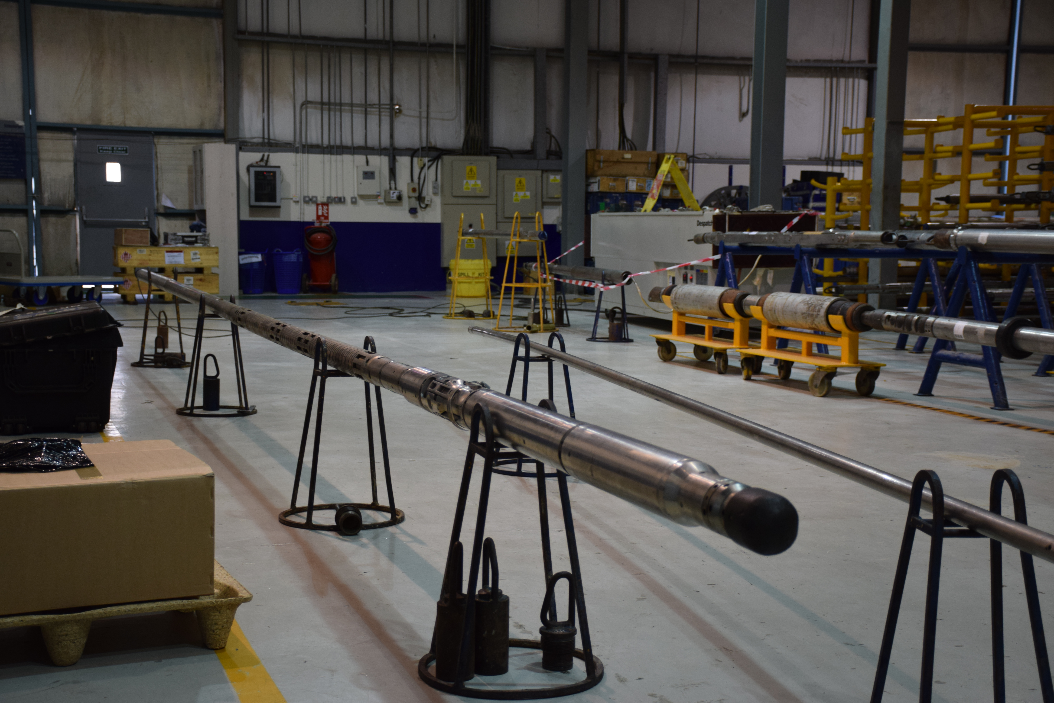
Ethnographic Study
Surveys and interviews to study the culture
Interviews with
Our mentor Dr. Shehab
Importance of data logging
RasGas company engineers
Operation of the tools
Engineers in Shlumberger
Familiarize ourselves with the tools

Slide 7
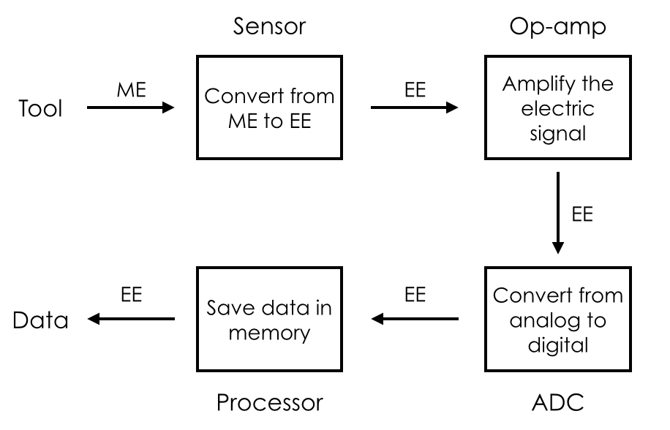
Functional Modeling

Slide 8
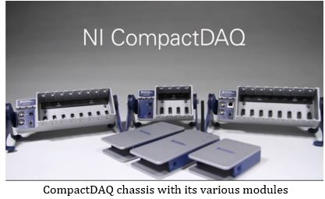
Benchmarking
Citations 3-5

Slide 9
Benchmarking
Metric | Our Design Project | H.E.A.T Evaluation Module | Compact DAQ (cDAQ-9134) | MSR145 (Standard IP 60)
Operation Time | 12 Hours | Infinite | Infinite | 2-3 Months
Power Source | Lithium Battery | 3.3 V External Supply | 24 V 5A External Supply | Lithium-polymer battery (800mAh)
Dimensions (LxWxH) | 5x1x1 inches | 15.6x1x0.93 inches | 8.66x4.6x3.4 inches | 2.8x1.5x0.9 inches
Sensors | Rotation, translation, vibration | Rotation, pressure, temperature | Holds 4 External Sensors from 50+ sensor modules | Holds 5 External Sensors from 8 different sensor modules or any analog signal
Memory | 2 MB | Onboard 32 Mbit | SD Card (Max 16 GB) | Onboard 8 Mbit
Acquisition Frequency | 20 Hz per second | Up to 128k per second | Up to 50k per second | Up to 50 per second
Temperature Tolerance | 175 ˚C | 210 ˚C | 70 ˚C | 65 °C
Connectivity | CAN | CAN | CAN/USB | USB
Price | N/A | $ 5749 | $ 7068 | $323 (Excluding Sensors)

Slide 10
Concept Generation
Function | Solutions
Time Tracking | Software based | Hardware based | Crystal
Measuring Position | Hall-effect sensor | LVDT | GPS
Measuring Vibration | Shock sensor | Accelerometer | Gyroscope
Retrieving Data | SD card | CAN | USB

Slide 11
Concept Selection
 |  | Concept Variant
Selection Criteria | Weight | A |  | B |  | C |  | D
 |  | Rating | Score | Rating | Score | Rating | Score | Rating | Score
Dimensions | 25% | 3 | 0.75 | 4 | 1 | 4 | 1 | 4 | 1
Operation Time | 20% | 4 | 0.8 | 2 | 0.4 | 2 | 0.4 | 3 | 0.6
Acquisition Frequency | 10% | 4 | 0.4 | 2 | 0.2 | 2 | 0.2 | 3 | 0.3
Memory Capacity | 10% | 4 | 0.4 | 4 | 0.4 | 4 | 0.4 | 4 | 0.4
Connectivity | 25% | 4 | 1 | 3 | 0.75 | 5 | 1.25 | 2 | 0.5
Cost | 10% | 4 | 0.4 | 3 | 0.3 | 3 | 0.3 | 3 | 0.3
Total Score |  | 3.75 |  | 3.05 |  | 3.55 |  | 3.1
Rank |  | 1 |  | 4 |  | 2 |  | 3
Continue |  | Yes |  | No |  | No |  | No

Slide 12
Preliminary Design
Technical Calculations:
Memory Capacity:
127Kb for 1Hz for 24h
1.23Mb for 10Hz for 24h
At 200Hz logging data for 113.7 min (Assuming a 2Mb Memory)
Run Time:
Assuming 100% operation and 1000mAh battery, run time is 6.5h.
2 cells would be sufficient to reach target run time.

Slide 13
Challenges
Design Constraints:
Power
Durability (Harsh Environment)
Size
Technical Challenges:
New programming environment.
Interfacing with mechanical systems/sensors.
Optimization/Meeting Deadlines.

Slide 14
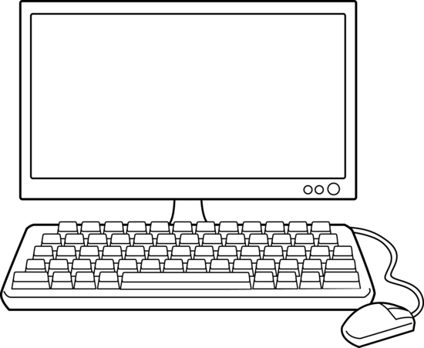
Design
Microcontroller
Sensor 1
Accelerometer
Op-Amp
Low-Pass Filter
Memory (ROM)
Sensor 2
Temp Sensor
Op-Amp
Low-Pass Filter
Timer
Op-Amp
Low-Pass Filter
ADC
Memory
Sensor 3
Hall Effect

Slide 15
Components and Budget
Parts Description | Quantity | Unit Price | Total
Accelerometer Dev Board | 2 | $40.30 | $80.60
dsPIC33EP64MC504 Plug-In-Module | 2 | $25.00 | $50.00
dsPICDEM 80-Pin Starter Development Board | 2 | $80.00 | $160.00
MPLAB ICD 3 In-Circuit Debugger | 1 | $200.00 | $200.00
External Memory - Micron M25P20-VMN3TPB | 3 | $6.00 | $18.00
MCP6401 Op-Amp | 10 | $0.5 | $5.00
Battery cells - Panasonic BR2477A | 10 | $3.31 | $33.14
Other Sensors | 4 | $100 | $400
Printed Circuit Board | 1 | $500.00 | $500.00
 |  |  | $1450.00
Requisition Sent To be ordered/Available
Citations 6-7

Slide 16
Progress and Future Work
Task/Month | January |  | February |  | March |  | April |  | May
dsPIC33 programming
Interface I/O and memory(Timers, Sensors)
Develop Code
First Prototype
Portability and efficiency optimization
PCB design and implementation
Final Report/Poster

Slide 17
Conclusion
Research helped us improve our design.
Important feedback and ideas to innovate our product.
Invest our time to develop a product that meet and exceeds expectations.

Slide 18
References
http://m.c.lnkd.licdn.com/
http://www.logwell.com/capabilities/
http://www.ti.com/tool/heatevm
http://www.ni.com/data_logger/modular.htm
http://www.cik-solutions.com/en/catalog/monitoring-datalogger/msr/products/
http://www.Microchipdirect.com/
http://www.mouser.com/

Slide 19
Thanks you for listening!
Any Questions?

