Slide 1
Data Logger For Mechanical Systems
Group 2:
Abdulrahman Al-Malki
Faisal Al-Mutawa
Mohammed Alsooj
Yasmin Hussein

Slide 2
Outline
Introduction: Abdulrahman
Overall Progress: Abdulrahman
Team Member Summary: All
Timeline and Conclusion: Mohammed

Slide 3
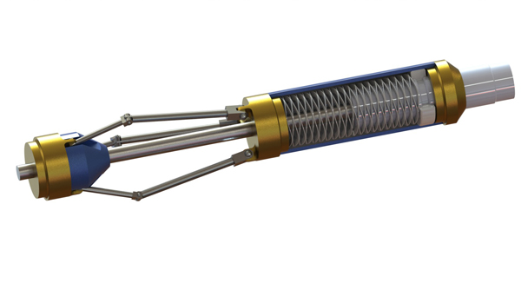
Introduction
Problem Statement
+our product
Dumb tool
Smart tool
Citations 1-2

Slide 4
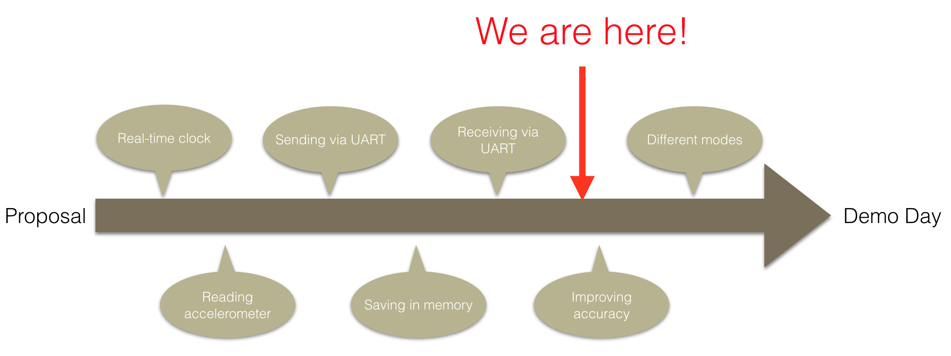
Progress - Programming
Figure 1

Slide 5
Progress - PCB
Figure 2

Slide 6
Progress & Plans - Abdulrahman
Accomplishments:
Designing real-time clock
Sending ADC output to HyperTerminal
Designing LabVIEW module for data plots
Current Work
Improving the UI of the LabVIEW module
Working on sending speed
Future Plans
Preparing for demo day

Slide 7
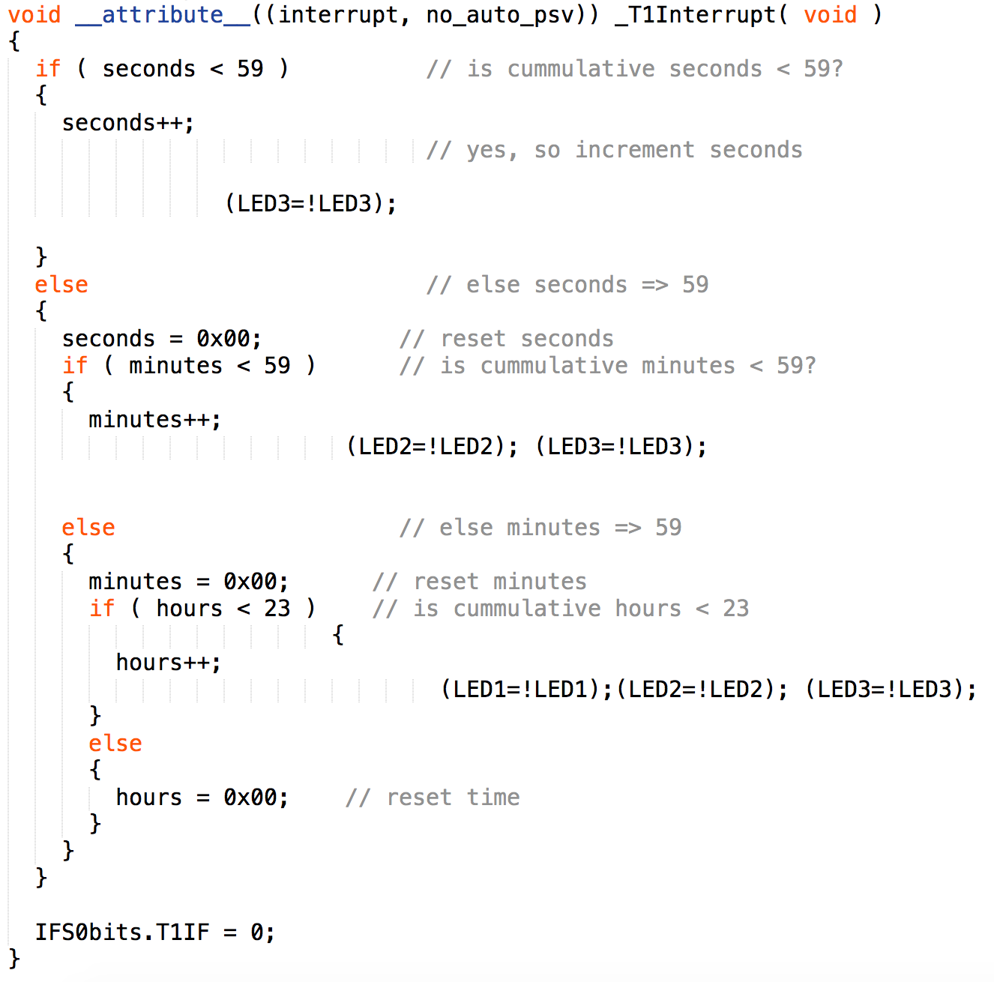
Programming - Real-time clock

Slide 8
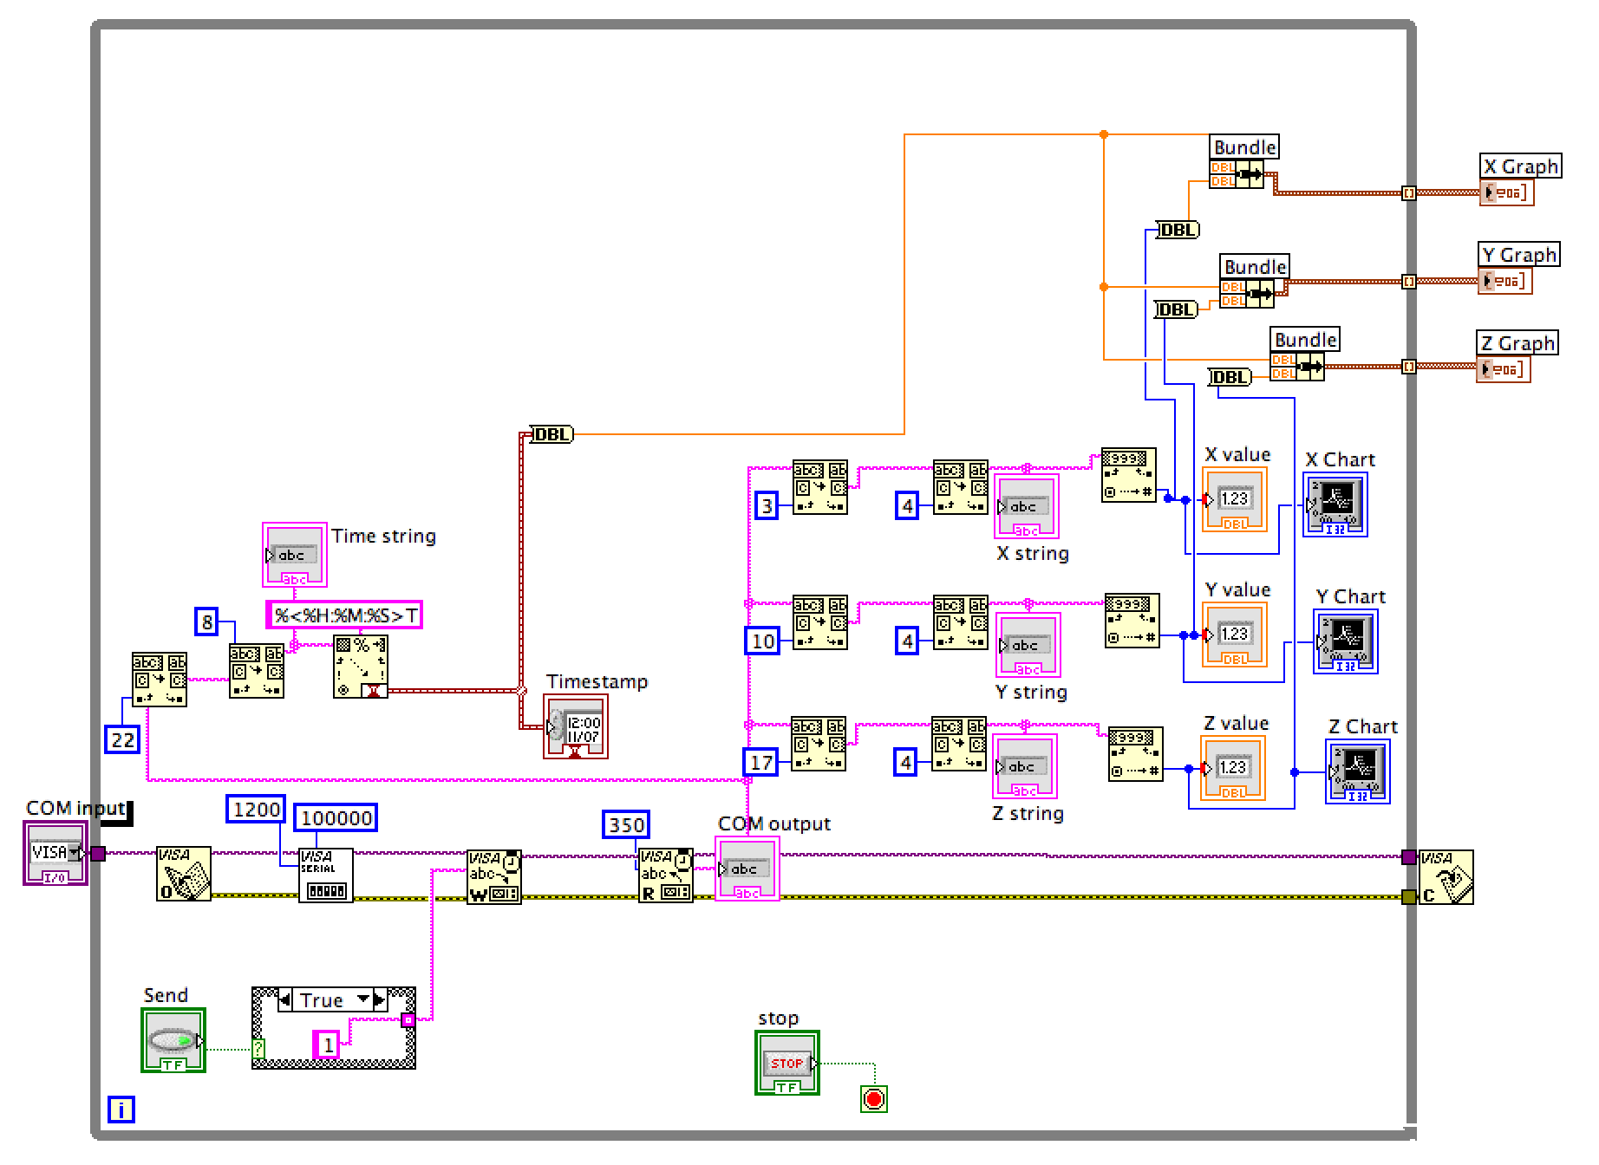
Programming - LabVIEW

Slide 9
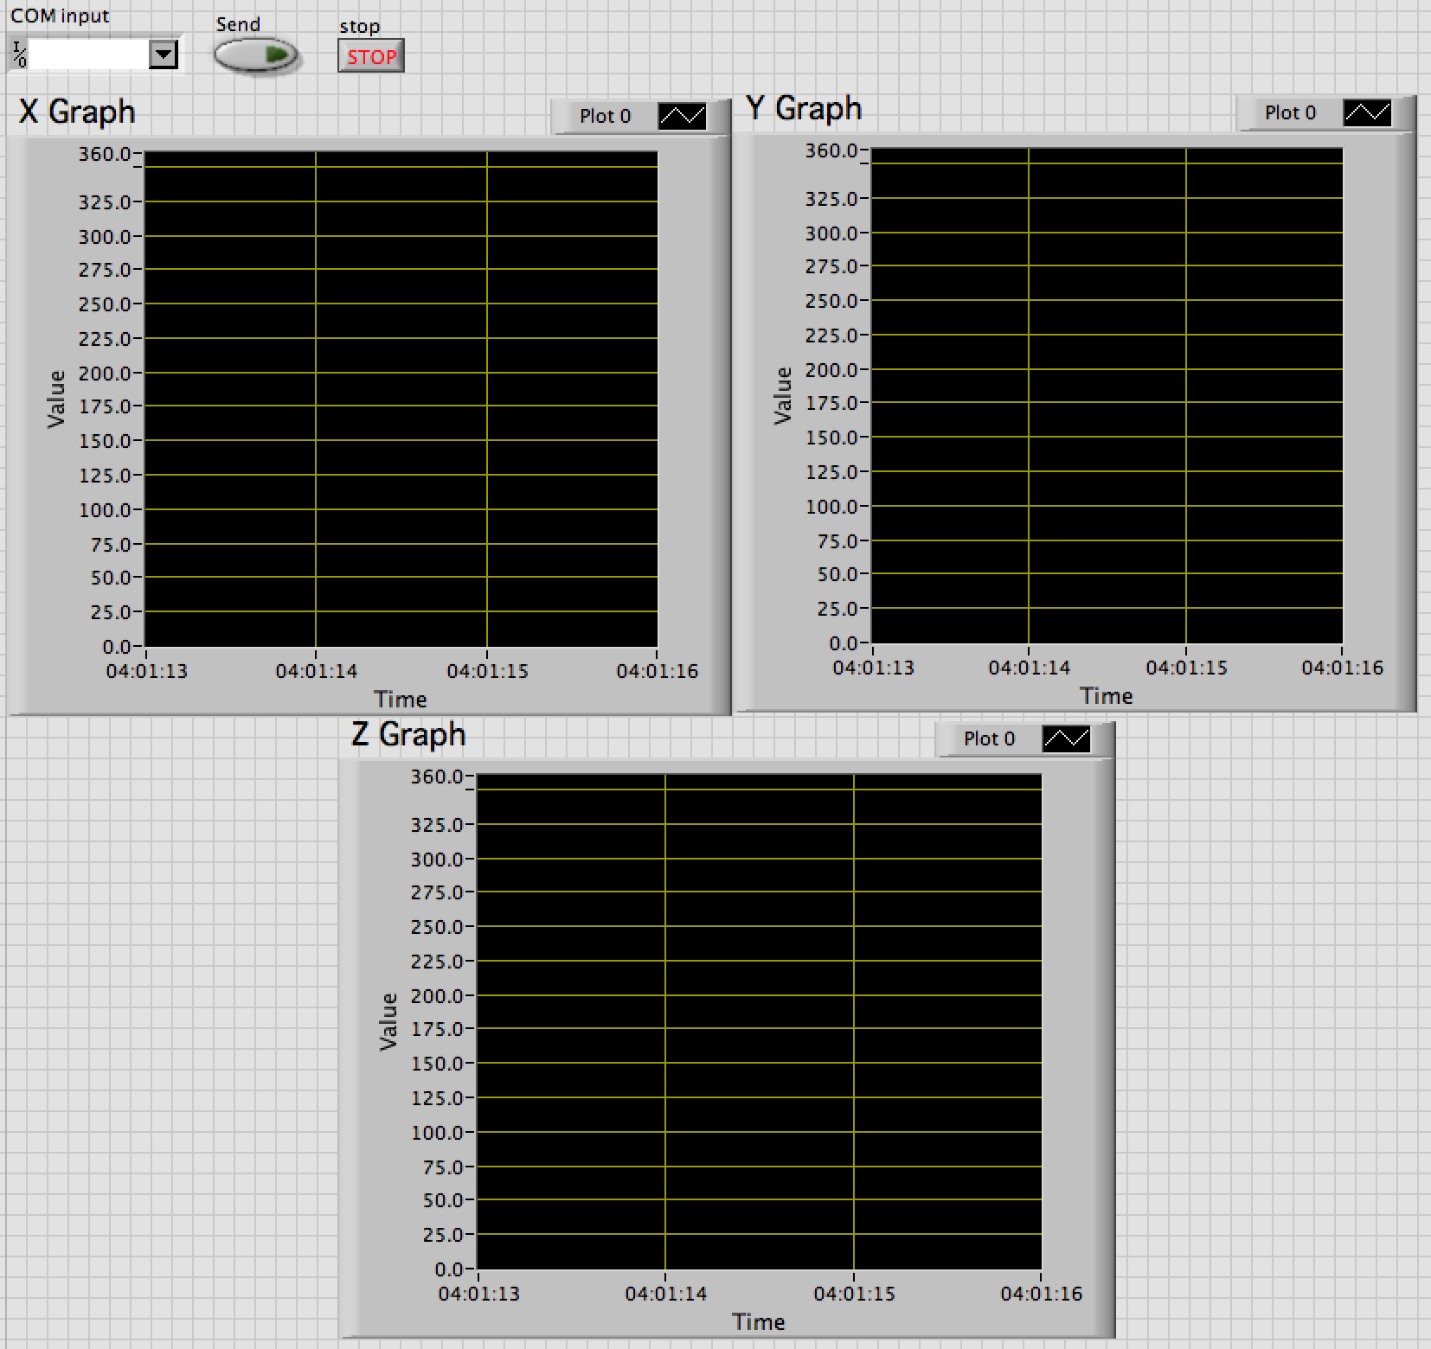
Programming - LabVIEW

Slide 10
Progress & Plans - Faisal
Accomplishments:
Code for ADC initialization of multiple channels to get Three Readings from the Accelerometer.
Send routine to perform calculations on the data points and send through RS-232. (interrupt Based)
Saving data points in the processors Data Space.
Used Buttons in order to Start/Stop and Send, but decided to go with another approach.
UART RS-232 is now configured to receive/send to be able to send data upon request.
Current Progress:
Currently working on the Threshold(); functionality.
Get Displacement/RPM from accelerometer values.
Future Plans:
Multiple operating modes.
Test the overall code on the PCB.
Issue a specification list for the Final Design.

Slide 11
Programming – Flow Chart
Start
Initialize
False
Time<x?
True
Read ADC Data
Read ADC Data
Stop ADC
Yes
UART Rx?
No
Initiate UART Tx transmission
Perform Calculations
Store in Memory
Perform Calculations
Yes
No
Over threshold?
Figure 3
UART Rx?
No
Yes

Slide 12
Programming – Call Graph
Initialize_RTC()
main()
Initialize_ADC()
Initialize_UART()
ReceiveUART()
ReadADC()
SaveADC()
SendUART()
Delay()
Mode()
Calculate()
Buttons()
LED()
Figure 4

Slide 13
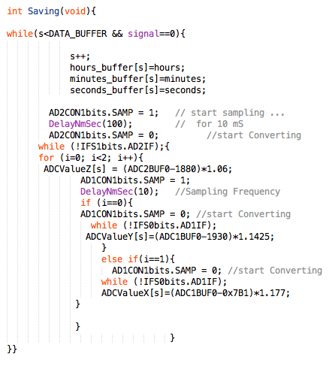
Saving the data
Saving up to 2550 readings.
Each reading includes:
accelerometer value (X,Y,Z).
Time Stamp (Hour, Minute, Second).
Stops when UART Rx interrupt is initiated or after a certain time

Slide 14
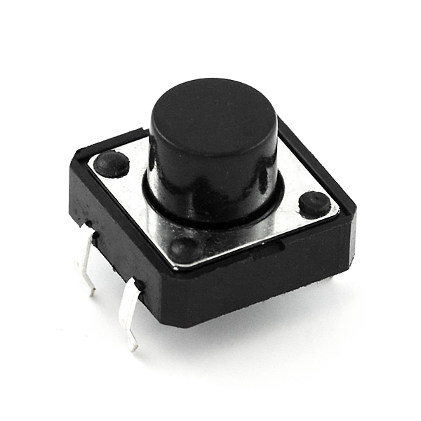
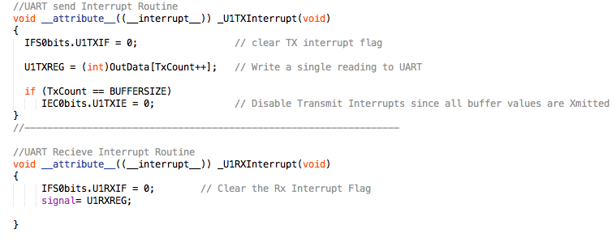
UART RS-232 Functions:
Interrupt based routine to both send and receive characters from/to Labview.
Can be used to Stop and Send. (Eliminating the need for buttons)

Slide 15
Current and future work
Currently working on a Threshold function.
Adding Rotations and Displacement as possible outcomes.
Implement multiple operating modes.
Table 1: Brief overview of the different modes of our project
Mode | Description
00 | Continuous logging/stops when memory is full
01 | Starts logging after certain threshold for a certain period
1x | Continuous low frequency logging with triggers increasing the sampling rate

Slide 16
Progress & Plans - Yasmin
Achievements:
Components List
PCB Schematic Design(Eagle)
Challenges:
Finding appropriate components
Errors in Schematic design
Future work:
Testing the PCB and soldering
Plastic Housing

Slide 17
Components
Table 9: Components used in the project along with the budget
Parts Description | Quantity | Unit Price | Total
dsPIC33FJ256GP710a processor | 1 | $9.37 | $9.37
Terminal blocks | 7 | $12.93 | $90.51
Crystal Oscillators | 2 | $0.36 | $0.72
Push buttons | 3 | $5.11 | $15.33
LEDs | 6 | $0.19 | $1.14
RS232 chip | 2 | $2.34 | $4.68
Serial port | 2 | $2.44 | $4.88
Connectors | 2 | $0.93 | $1.86
Full-bridge rectifier | 2 | $0.69 | $1.38
Capacitors (22p, 33p,0.1u, 0.47 u, 10u, 470u) | 40 | N/A | $355.48
Resistors (10, 100, 250, 410, 470, 4.7k) | 28 | N/A | $42.00
KXD94 and KXR94 accelerometer chips | 4 | $9.87 | $6.00
QSTB40 diode | 2 | $0.90 | $3.00
Total |  |  | $536.35

Slide 18
Schematics – Progress
Table 2: Components to be built
PCB Design | Status
LED indicators | Completed
ICD3 connector | Completed
Push Button Switches | Completed
Power Supply | Completed
Processor | Completed
Oscillators | Completed
Accelerometer | Completed
Layout | Completed
Printing the PCB | Pending…
Soldering the components | Pending…

Slide 19
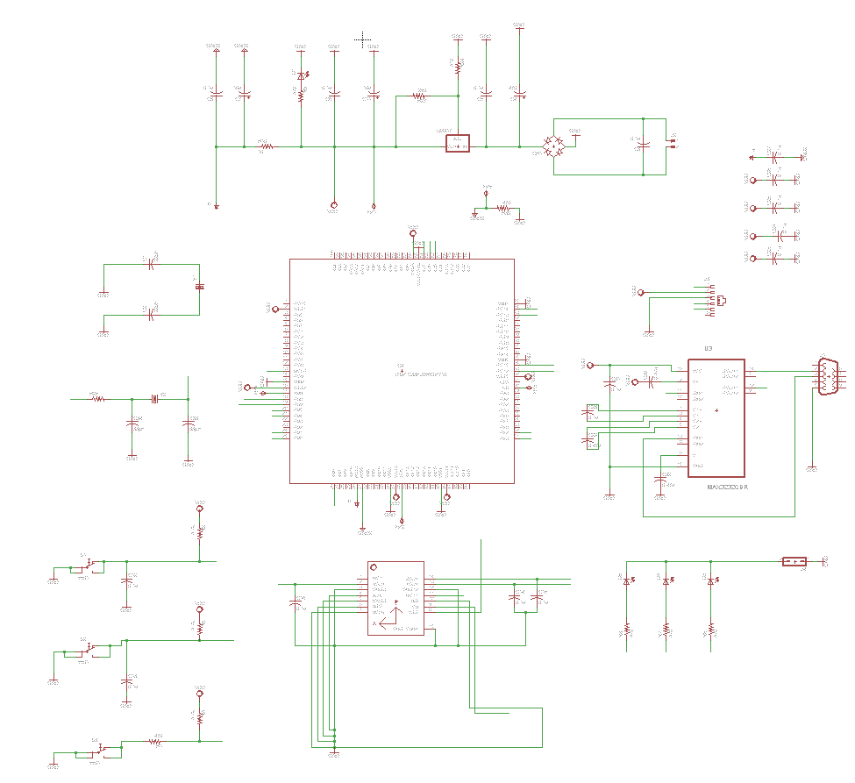
Schematic

Slide 20
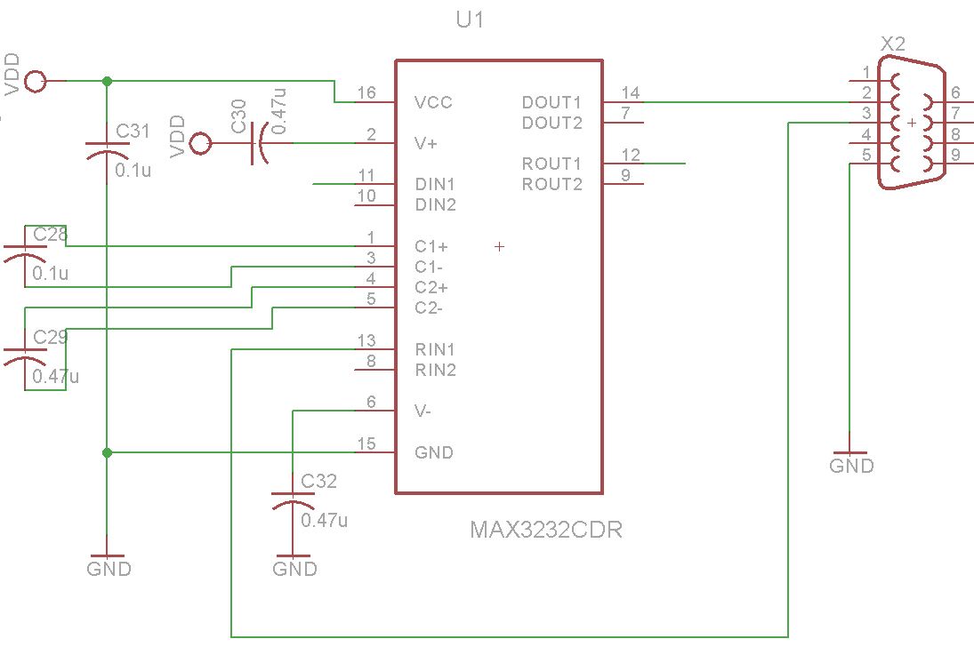
Schematics – Serial port

Slide 21
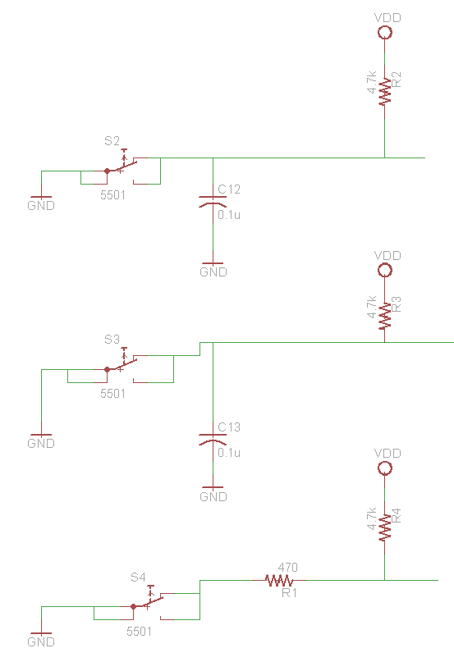
Schematics – Push Buttons

Slide 22
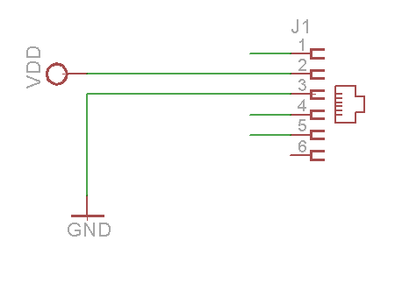
Schematics - Connector

Slide 23
Schematics – LED

Slide 24
Schematics –Accelerometer

Slide 25
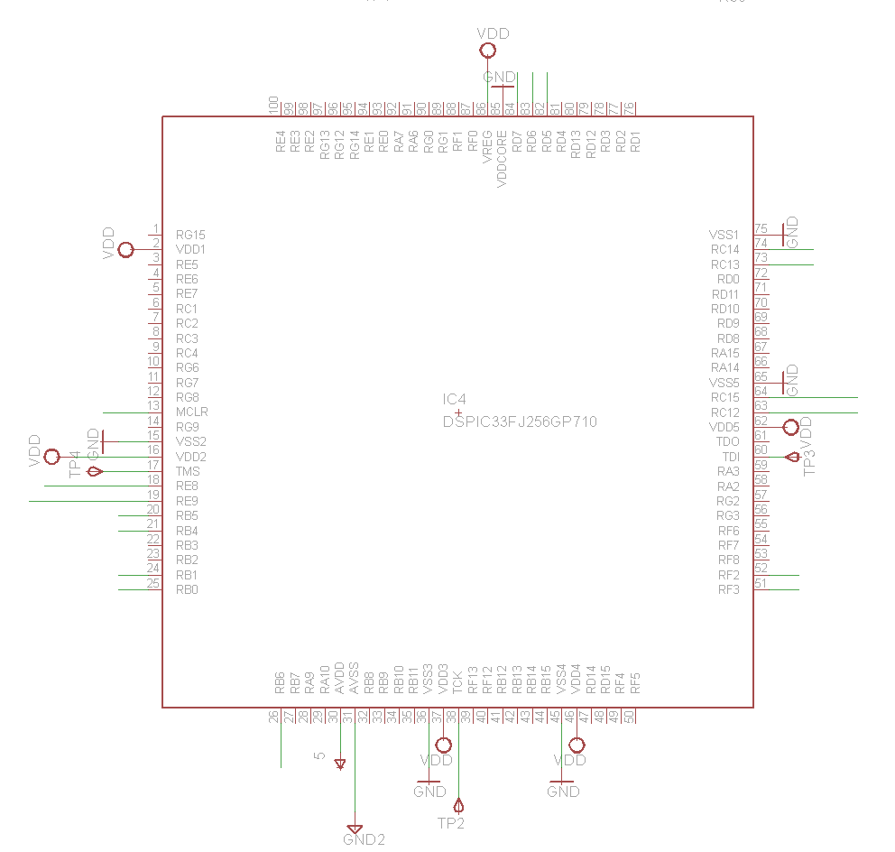
Schematics – Processor

Slide 26
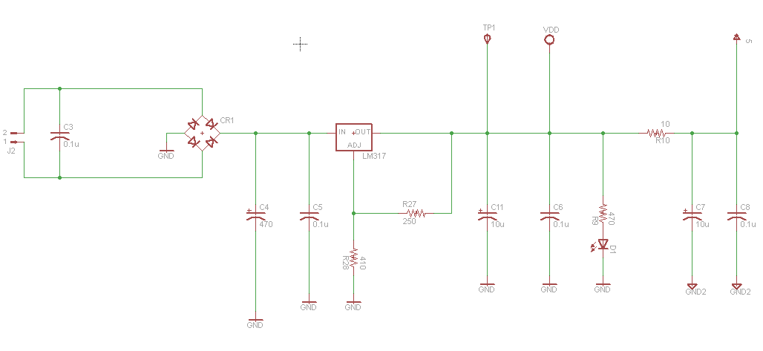
Schematics – Power Supply

Slide 27
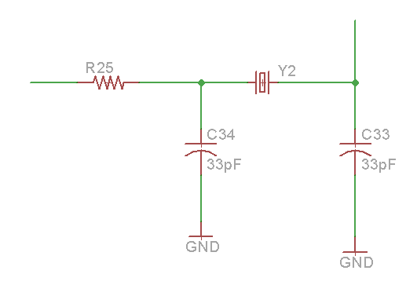
Schematics – Oscillators

Slide 28
PCB layout

Slide 29
Processor and Power supply

Slide 30
Accelerometer

Slide 31
Connectors

Slide 32
Switches and LEDs

Slide 33
Timeline
Table 3: Project timeline for the spring semester
Task | January |  |  |  | February |  |  |  | March |  |  |  | April
 | W1 | W2 | W3 | W4 | W1 | W2 | W3 | W4 | W1 | W2 | W3 | W4 | W1 | W2 | W3 | W4
Designing real-time clock
Establishing UART connection
Designing PCB schematic
Programming accelerometer
Interfacing memory
Ordering components
Finalize PCB routing
Design plastic housing
Final testing
Preparing for Demo Day

Slide 34
Progress & Plans - Mohammed
Achievements:
Designing a new PCB that has a built in accelerometer
Creating a layout for the PCB and routing the wires
Challenges:
Searching and adding libraries that has the specific components needed for the PCB
Positioning the PCB layout parts
Routing the wires in shortest and non-overlapping paths
Current Progress:
Separating component parts into many boards.
Future work:
Add more sensors in the PCB for our data logger
Reduce the size of the PCB
Improve power efficiency by adding Buck convertor

Slide 35
Conclusion
Logging Data
Design PCB and program it
Casing

Slide 36
References
http://m.c.lnkd.licdn.com/
http://www.logwell.com/capabilities/

Slide 37
Thank you for listening!
Any questions?

