Slide 1
Data Logger For Mechanical Systems
Group 2:
Abdulrahman Al-Malki
Faisal Al-Mutawa
Mohammed Alsooj
Yasmin Hussein

Slide 2
Outline
Project overview: Abdulrahman
Programming: Faisal
Components: Yasmin
PCB Design and Progress: Yasmin/Mohammed
Progress and Conclusion: Mohammed

Slide 3
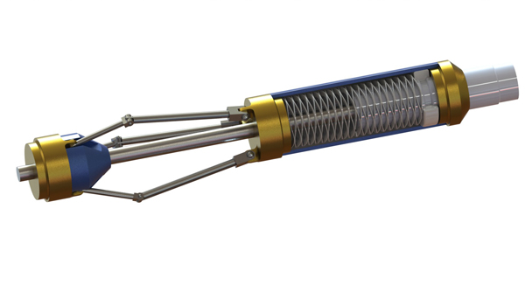
Project Overview
Same objective…
+our product
Dumb tool
Smart tool
Citations 1-2

Slide 4
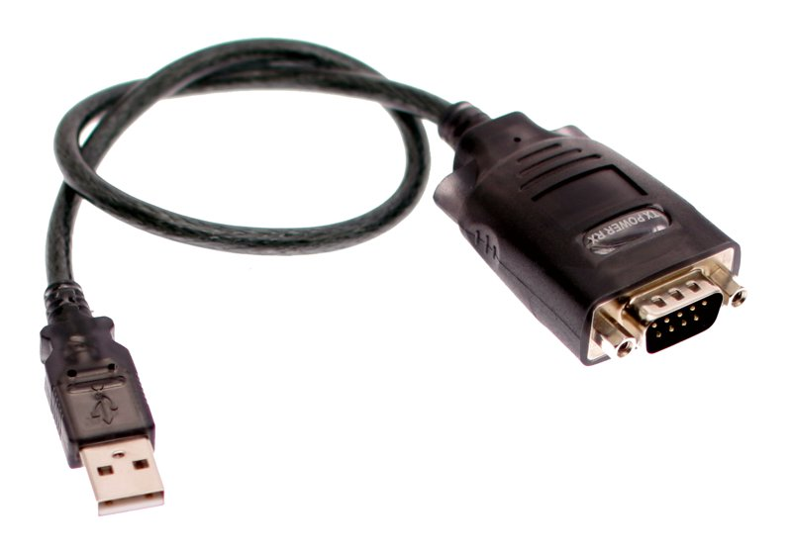
Project Overview
Different Execution
Citations 3-5

Slide 5
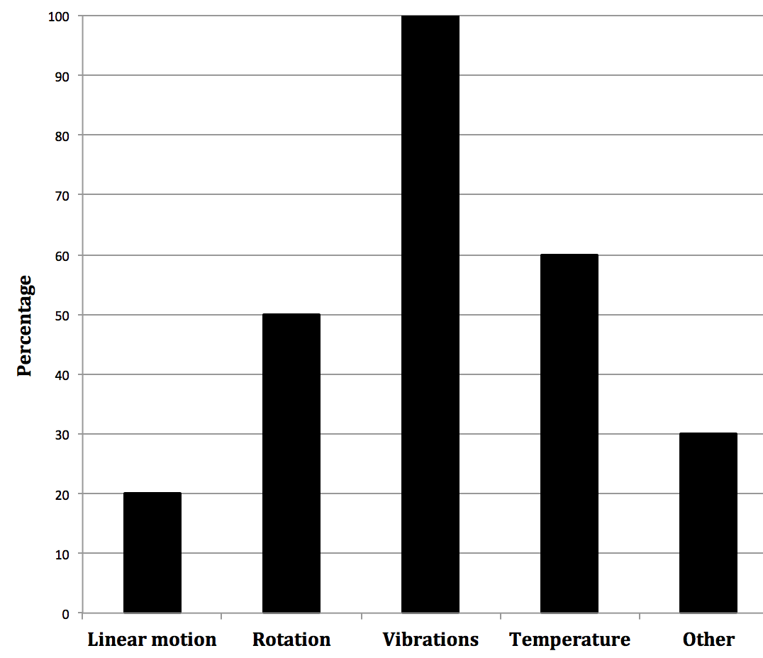
Market Analysis – Customer Needs
Two personal interviews and one phone interview
Focus on:
Vibration and rotation
Prioritize accuracy
Figure 1

Slide 6
Market Analysis - Benchmarking
Table 1: Comparison between our project and an existing product
Metric | Our Design Project | H.E.A.T Evaluation Module
Power Source | Lithium Battery | 3.3 V External Supply
Dimensions (LxWxH) | 5x1x1 inches | 15.6x1x0.93 inches
Sensors | Rotation and vibration | Rotation, pressure, temperature
Memory | 64 KB | 32 MB
Acquisition Frequency | 20 Hz | Up to 128k Hz
Connectivity | USB | CAN
Citations 6

Slide 7
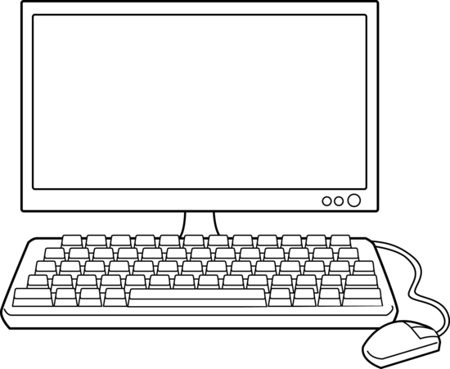
Top-level Model
Our Project
Motion
Figure 2
Software: Abdulrahman and Faisal
Hardware: Mohammed and Yasmin

Slide 8
Programming – Flow Chart
Start
Initialize
False
Time<x?
True
Read ADC Data
Read ADC Data
Perform Calculations
Store in Memory
Perform Calculations
No
Over threshold?
Yes
Figure 3

Slide 9
Programming – Call Graph
Initialize_RTC()
Initialize_ADC()
main()
ReceiveUART()
ReadADC()
Store()
SendUART()
Delay()
Mode()
CalculateADC()
Buttons()
LED()
Figure 4

Slide 10
Programming – Functions
Table 2: Details about the functions used in our project
Function | Description
Main(); | Calls top-level functions
Initialize_RTC(); Initialize_ADC(); | Initialization for time & inputs
ReadADC(); | Read 3-analogue data inputs from sensor
SendUART(); ReceiveUART(); | Send data via RS-232 serial com.
Mode(); | Select mode or trigger of Data Acquisition
CalculateADC(); | Perform calculations of ADC Data
Store(); | Store calculated outputs in memory with a timestamp

Slide 11
Programming - Modes
Table 2: Brief overview of the different modes of our project
Mode | Description
00 | Continuous logging/stops when memory is full
01 | Starts logging after certain trigger for a certain period
1x | Continuous low frequency logging with triggers increasing the sampling rate

Slide 12
Main Components
Terminal Blocks
Crystal Oscillators
Push button Switches
LED
Chip (MAX323CD)
Connector
Capacitors
Resistors

Slide 13
Schematics – Progress Report
Components Schematic | Status
LED indicators | Completed
ICD2 connector | Completed
Push Button Switches | Completed
Power Supply | Completed
Processor | Completed
Oscillators | Completed
Accelerometer | Pending…

Slide 14
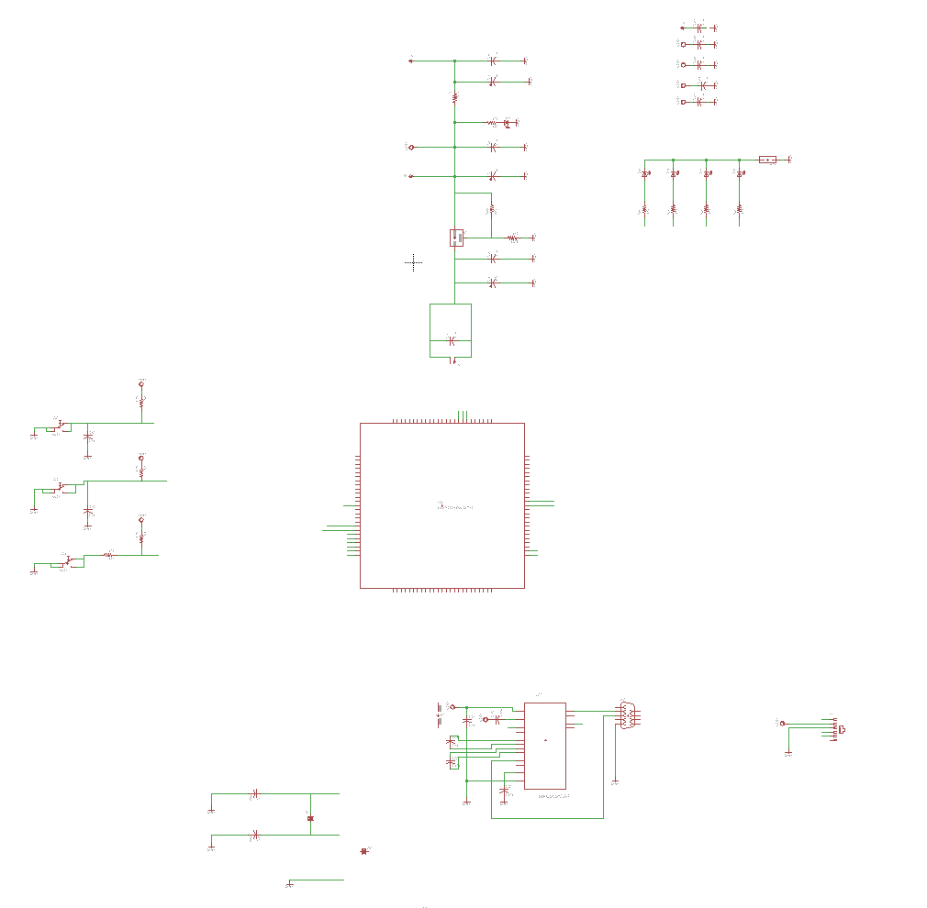
Schematic

Slide 15
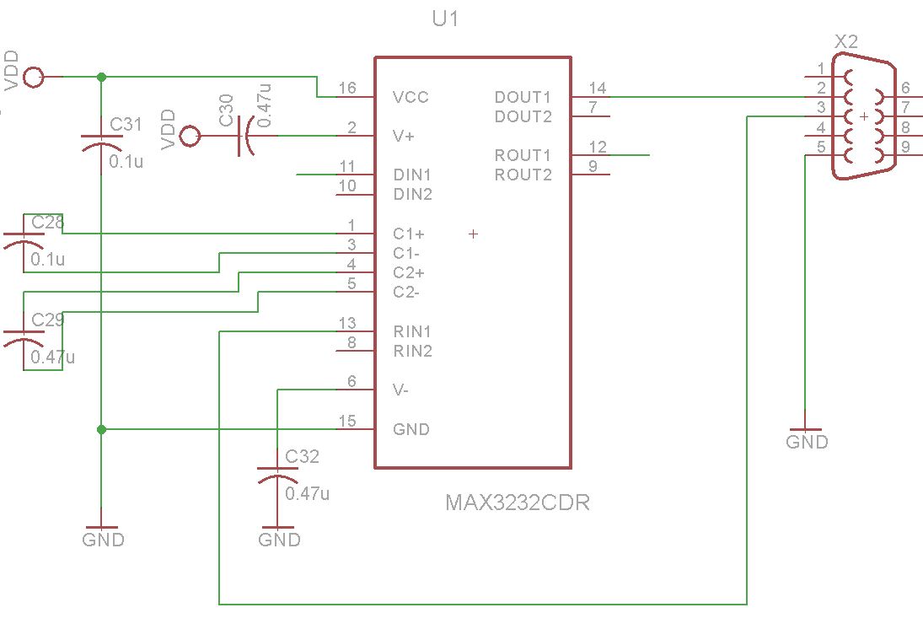
Schematics – Serial port

Slide 16
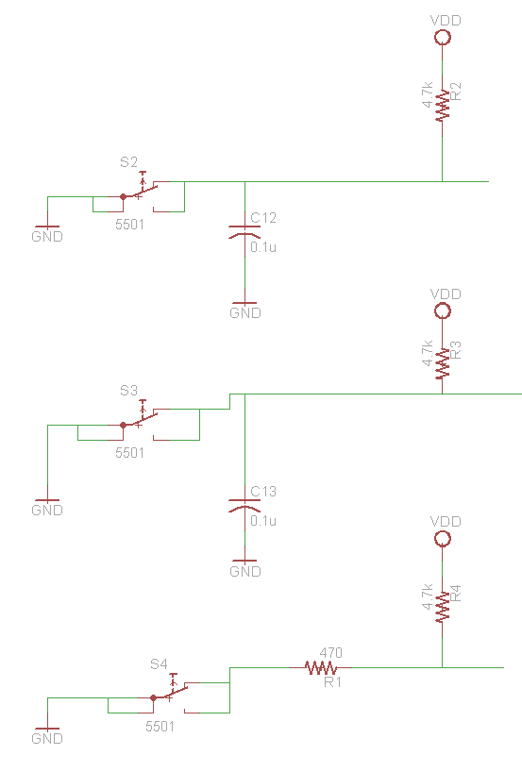
Schematics – Push Buttons

Slide 17
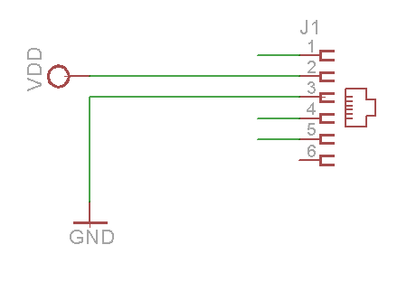
Schematics - Connector

Slide 18
Schematics – LED

Slide 19
References
http://m.c.lnkd.licdn.com/
http://www.logwell.com/capabilities/
http://www.solidworks.com/
http://www.yourcablestore.com/assets/
http://76.my/Malaysia/high-quality-usb-2-0-to-rs232-9-pin-serial-cable-1-5m-chocobozz
http://www.ti.com/tool/heatevm
http://www.mouser.com/

Slide 20
Thank you for listening!
Any Questions?

