Slide 1
Data Logger For Mechanical Systems
Group 2:
Abdulrahman Al-Malki
Faisal Al-Mutawa
Mohammed Alsooj
Yasmin Hussein
Mentor:
Dr. Shehab Ahmed

Slide 2
Progress Diagram
Research
Hardware Design
Troubleshooting
Proposal
Demo Day
Software Design I
Software Design II

Slide 3
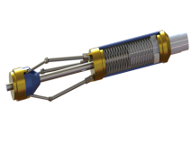
Introduction
Problem Statement
+our product
Dumb tool
Smart tool
Citations 1-2

Slide 4
Progress Diagram
Research
Proposal
Demo Day

Slide 5
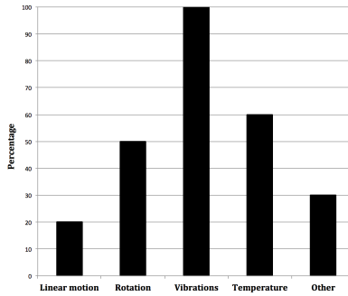
Market Analysis – Customer Needs
Two personal interviews and one phone interview
Focus on:
Rotation is desired
Prioritize accuracy
Figure 1

Slide 6
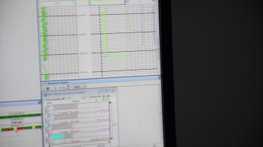
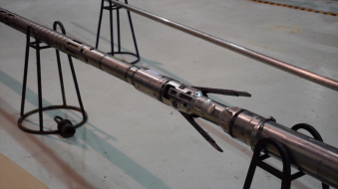
Market Analysis - Ethnographic Study
RasGas and Schlumberger visits.
Background information about mechanical tools.
Focused on down-hole tools used in the oil & gas industry.

Slide 7
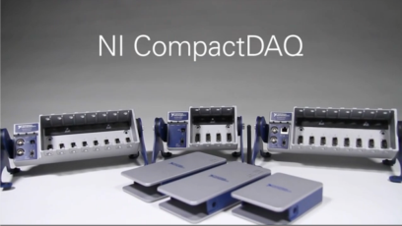
Market Analysis – Benchmarking
Figure 2

Slide 8
Market Analysis – Benchmarking
Table 1: Comparison between our project and an existing product
Metric | Our Design Project | H.E.A.T Evaluation Module
Power Source | 9V battery | 3.3 V External Supply
Dimensions (LxWxH) | 7x2x1 inches | 15.6x1x0.93 inches
Data Type | Tilt angles | Rotation, pressure, temperature
Memory | 32 KB | 32 MB
Acquisition Frequency | Up to 100 Hz | Up to 128k Hz
Connectivity | Serial to USB | CAN
Citation 3

Slide 9
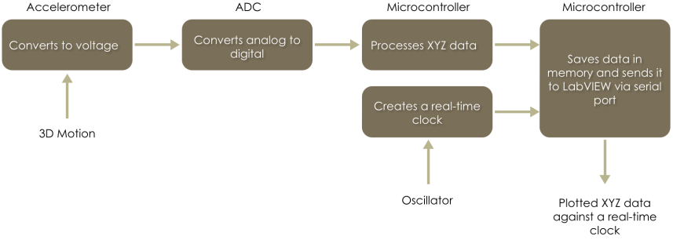
Functional Modeling
Figure 3

Slide 10
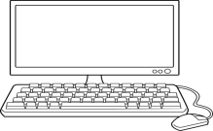
Top-level Model
Our Project
Motion
Figure 4
Software: Abdulrahman and Faisal
Hardware: Mohammed and Yasmin

Slide 11
Progress Diagram
Research
Proposal
Demo Day
Software Design I

Slide 12
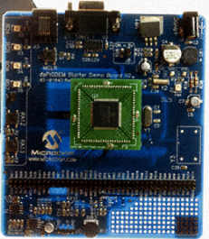
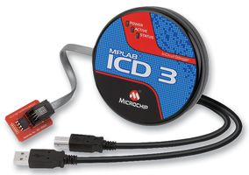
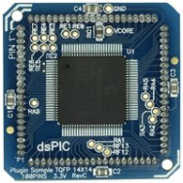
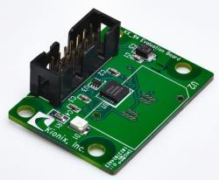
Development Environment
Hardware:
dsPIC33FJ
dsPICDEM Starter Development Board
MPLAB ICD3 In-Circuit Debugger
Kionix KXD94 Evaluation Board
Software:
MPLAB X IDE
XC16 Compiler
Citations 4-5

Slide 13
Programming – Flow Chart
Start
Initialize
False
Time<x?
True
Read ADC Data
Read ADC Data
Stop ADC
Yes
UART Rx?
No
Initiate UART Tx transmission
Perform alculations
Store in Memory
Perform Calculations
Yes
No
Over threshold?
Figure 5
UART Rx?
No
Yes

Slide 14
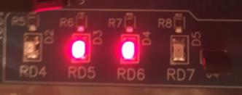
Programming – RTC
Real-time clock for “Time-Stamping” logs
Uses an external oscillator of 32.768Khz
Interrupt based
Accurate up to 100ms (HH:MM:SS.U)

Slide 15
Programming – ADC/Saving
ADC:
Analog to Digital Conversion using dsPIC built in ADC unit
3 Channels: Ch0 for X, Ch1 for Y, Ch2 for Z
Sampling rate up to 100 Samples/Sec
Saving Routine:
Using the dsPIC 32KB memory to save up to 2500 readings
Each reading includes:
accelerometer value (X,Y,Z)
Time Stamp (Hour, Minute, Second, Millisecond)

Slide 16
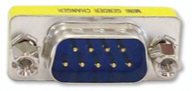
Programming – Send/Receive
UART RS-232 Connection to the PC
Interrupt based
Received signal initiate transmission/sending
At 19200 Baud Rate
Citation 6

Slide 17
Programming – Threshold Mode
±1.5g< Acceleration in any axis starts the logging process
“Shake to Log”
Real-life application, sudden change of velocity
Bump against a wall/ Hitting an obstacle/ sudden stops
Logs after threshold for a specified period of time

Slide 18
Programming – Call Graph
Initialize_UART()
main()
Initialize_ADC()
Initialize_RTC()
SetupPorts()
LED()
ReceiveUART()
ReadADC()
Threshold()
SendUART()
Delay()
SaveADC()
Figure 6

Slide 19
Progress Diagram
Research
Hardware Design
Proposal
Demo Day
Software Design I

Slide 20
PCB Design
Requirements:
3.3 V to power the processor
Oscillators
Connection with the user’s PC (19200 Baud rate)
Integrated accelerometer
Constraints:
Powered by 9 V battery
PCB not wider than the tool (<2 inches)

Slide 21
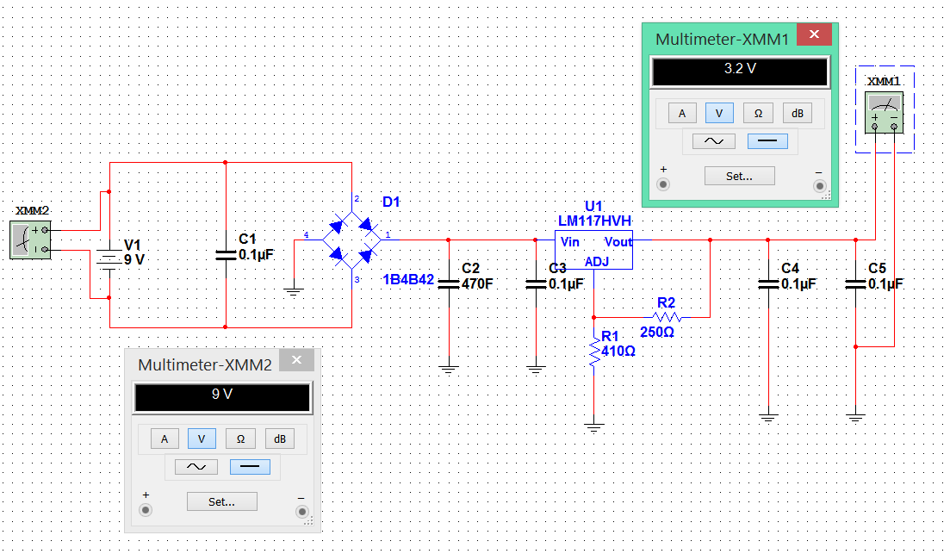
Power Simulation
Figure 7

Slide 22
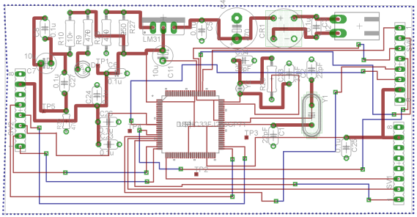
Processor and Power
Two oscillators:
7.3 MHz to get the required baud rate
32.768 kHz for all other functions
On its own board for the width requirement
Figure 8

Slide 23
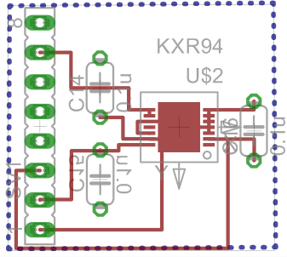
Peripheral PCBs
Accelerometer PCB
Figure 9a

Slide 24
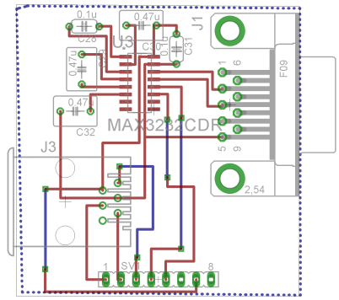
Peripheral PCBs
Accelerometer PCB
Connectors PCB:
RS232 port
RJ5 port
Figure 9b

Slide 25
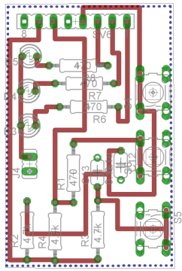
Peripheral PCBs
Accelerometer PCB
Connectors PCB:
RS232 port
RJ5 port
Debugging PCB:
3 LEDs
3 buttons
Figure 9c

Slide 26
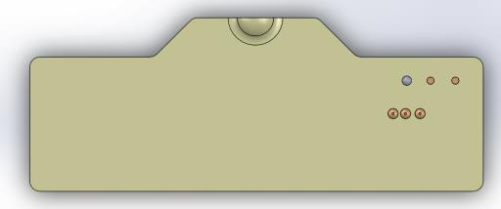
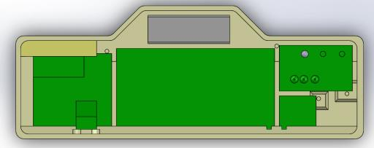
Plastic Housing
Openings for the buttons and LEDs
Figure 10a

Slide 27
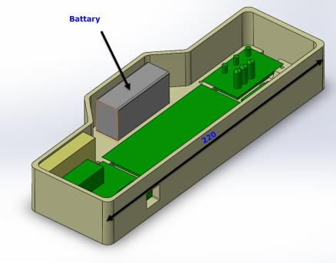
Plastic Housing
Openings for the buttons and LEDs
Openings for the ports
Battery Compartment
Figure 10b

Slide 28
Progress Diagram
Research
Hardware Design
Proposal
Demo Day
Software Design I
Software Design II

Slide 29
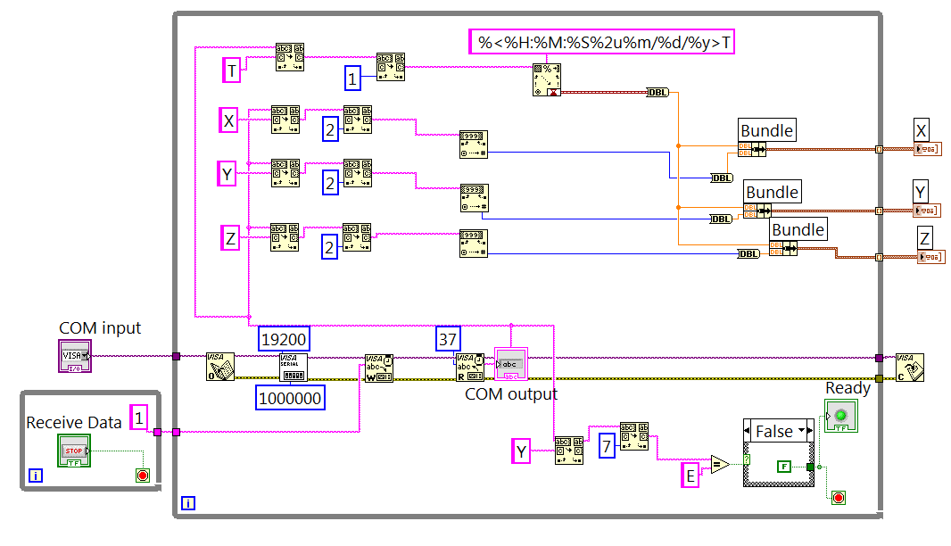
Software for the End User
“X:+004 Y:-122 Z:+067T08:55:07.6”
Figure 11

Slide 30
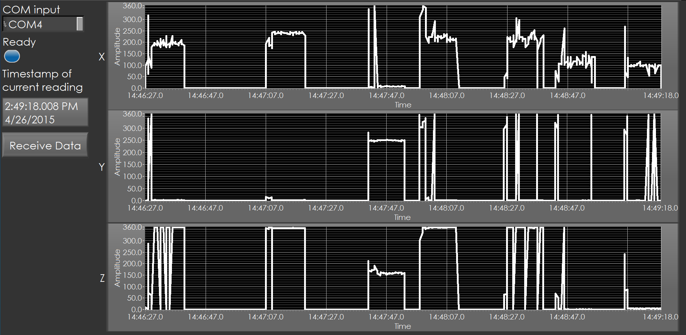

Slide 31
Progress Diagram
Research
Hardware Design
Troubleshooting
Proposal
Demo Day
Software Design I
Software Design II

Slide 32
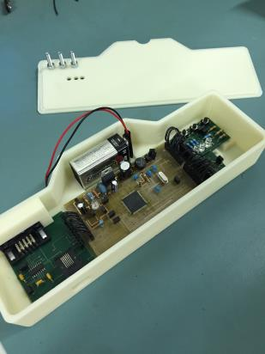
Troubleshooting
Four PCBs instead of one
Processor’s memory instead of external memory

Slide 33
Conclusion
Table 3: Project Final Specifications
Power Source | 9V battery
Dimensions (LxWxH) | 7x2x1 inches
Data Type | Tilt angles
Memory | 32 KB (25k samples)
Acquisition Frequency | Up to 100 Hz
Connectivity | Serial to USB
Final specifications
Future work
Add more sensors
Single board design
Add external memory
Harsh environment components

Slide 34
Acknowledgments
Special thanks to Mr. Wesam, Dr. Ziyad, and Mr. Ali for helping us throughout the project.
Special thanks to Dr. Shehab, Dr. Haitham, Dr. Beena, Dr. Mazen for making this project possible.

Slide 35
References
Downhole Tools Market Analysis, Size, Share, Trends and Forecast 2020 by Sandip Ghate
Downhole Tools. Logwell. Retrieved from http://www.logwell.com/capabilities/downhole_tools.html
H.E.A.T. Board. Texas Instruments. Retrieved from http://www.ti.com/tool/HEATEVM
MPLAB. Microchip. http://www.microchip.com/mplabx
KXD94. Kionix. http://www.kionix.com/accelerometers/kxd94
RS232 Adapter. Yourcablestore. http://www.yourcablestore.com/DB9-Male-To-Male-9-Pin-Serial-Port-RS232-Adapter_p_277.html

Slide 36
Thank you for listening!
Any questions?

